Slide 1
CS 219
Sorting Algorithms

Slide 2
Road Map
Program/code
time complexity
analysis
Sorting
algorithms
Data Structure
Graph
algorithms
& data structure
Insertion Sort
Merge Sort
Quick Sort
Divide & Conquer
Dynamic Programming

Slide 3
Sorting Algorithms
Input:
A sequence of n numbers a₁, a₂, . . . , a_{n}
Output:
A permutation (reordering) a₁’, a₂’, . . . , a_{n}’ of the input sequence such that a₁’ ≤ a₂’ ≤ · · · ≤ a_{n}’

Slide 4
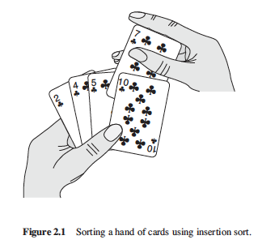
Why Study Sorting Algorithms?
There are a variety of situations that we can encounter
Various algorithms are better suited to some of these situations

Slide 5
Insertion Sort

Slide 6
Insertion Sort – Example
Unsorted
Array A
30
10
40
20
value
index
0
1
2
3
TASK: sort the array in a
non-decreasing order

Slide 7
Insertion Sort – Example
30
10
40
20
Currently focused element:
value
A[0] = 30
index
0
1
2
3

Slide 8
Insertion Sort – Example
30
10
40
20
Currently focused element:
value
A[1] = 10
index
0
1
2
3

Slide 9
Insertion Sort – Example
30
10
40
20
Currently focused element:
value
A[1] = 10
index
0
1
2
3

Slide 10
Insertion Sort – Example
10
30
40
20
Currently focused element:
value
A[1] = 10
index
0
1
2
3

Slide 11
Insertion Sort – Example
10
30
40
20
Currently focused element:
value
A[2] = 40
index
0
1
2
3

Slide 12
Insertion Sort – Example
10
30
40
20
Currently focused element:
value
A[2] = 40
index
0
1
2
3

Slide 13
Insertion Sort – Example
10
30
40
20
Currently focused element:
value
A[2] = 40
index
0
1
2
3

Slide 14
Insertion Sort – Example
10
30
40
20
Currently focused element:
value
A[3] = 20
index
0
1
2
3

Slide 15
Insertion Sort – Example
10
30
40
20
Currently focused element:
value
A[3] = 20
index
0
1
2
3

Slide 16
Insertion Sort – Example
10
30
20
40
Currently focused element:
value
A[3] = 20
index
0
1
2
3

Slide 17
Insertion Sort – Example
10
30
20
40
Currently focused element:
value
A[3] = 20
index
0
1
2
3

Slide 18
Insertion Sort – Example
10
20
30
40
Currently focused element:
value
A[3] = 20
index
0
1
2
3

Slide 19
Insertion Sort – Example
10
20
30
40
Currently focused element:
value
A[3] = 20
index
0
1
2
3

Slide 20
Insertion Sort – Example
10
20
30
40
value
Sorted Array A
index
0
1
2
3

Slide 21
Insertion Sort – Implementation
Unsorted array
InsertionSort(A, n) { for i = 1 to n-1 { key = A[i] j = i - 1; while (j >= 0) and (A[j] > key) A[j+1] = A[j] j = j - 1 } A[j+1] = key }
}
Array length
Currently focused element
Swipe these
two elements

Slide 22
Insertion Sort – Execution
30
10
40
20
i = ∅ j = ∅ key = ∅ A[j] = ∅ A[j+1] = ∅
0
1
2
3
InsertionSort(A, n) { for i = 1 to n-1 { key = A[i] j = i - 1; while (j >= 0) and (A[j] > key) { A[j+1] = A[j] j = j - 1 } A[j+1] = key }
}

Slide 23
Insertion Sort – Execution
30
10
40
20
i = 1 j = 0 key = 10 A[j] = 30 A[j+1] = 10
0
1
2
3
InsertionSort(A, n) { for i = 1 to n-1 { key = A[i] j = i - 1; while (j >= 0) and (A[j] > key) { A[j+1] = A[j] j = j - 1 } A[j+1] = key }
}

Slide 24
Insertion Sort – Execution
30
30
40
20
i = 1 j = 0 key = 10 A[j] = 30 A[j+1] = 30
0
1
2
3
InsertionSort(A, n) { for i = 1 to n-1 { key = A[i] j = i - 1; while (j >= 0) and (A[j] > key) { A[j+1] = A[j] j = j - 1 } A[j+1] = key }
}

Slide 25
Insertion Sort – Execution
30
30
40
20
i = 1 j = -1 key = 10 A[j] = 30 A[j+1] = 30
0
1
2
3
InsertionSort(A, n) { for i = 1 to n-1 { key = A[i] j = i - 1; while (j >= 0) and (A[j] > key) { A[j+1] = A[j] j = j - 1 } A[j+1] = key }
}

Slide 26
Insertion Sort – Execution
30
30
40
20
i = 1 j = -1 key = 10 A[j] = ∅ A[j+1] = 30
0
1
2
3
InsertionSort(A, n) { for i = 1 to n-1 { key = A[i] j = i - 1; while (j >= 0) and (A[j] > key) { A[j+1] = A[j] j = j - 1 } A[j+1] = key }
}

Slide 27
Insertion Sort – Execution
10
30
40
20
i = 1 j = -1 key = 10 A[j] = ∅ A[j+1] = 10
0
1
2
3
InsertionSort(A, n) { for i = 1 to n-1 { key = A[i] j = i - 1; while (j >= 0) and (A[j] > key) { A[j+1] = A[j] j = j - 1 } A[j+1] = key }
}

Slide 28
Insertion Sort – Execution
10
30
40
20
i = 1 j = -1 key = 10 A[j] = ∅ A[j+1] = 10
0
1
2
3
InsertionSort(A, n) { for i = 1 to n-1 { key = A[i] j = i - 1; while (j >= 0) and (A[j] > key) { A[j+1] = A[j] j = j - 1 } A[j+1] = key }
}

Slide 29
Insertion Sort – Execution
10
30
40
20
i = 2 j = -1 key = 40 A[j] = ∅ A[j+1] = 10
1
2
3
4
InsertionSort(A, n) { for i = 1 to n-1 { key = A[i] j = i - 1; while (j >= 0) and (A[j] > key) { A[j+1] = A[j] j = j - 1 } A[j+1] = key }
}

Slide 30
Insertion Sort – Execution
10
30
40
20
i = 2 j = 1 key = 40 A[j] = 30 A[j+1] = 40
0
1
2
3
InsertionSort(A, n) { for i = 1 to n-1 { key = A[i] j = i - 1; while (j >= 0) and (A[j] > key) { A[j+1] = A[j] j = j - 1 } A[j+1] = key }
}

Slide 31
Insertion Sort – Execution
10
30
40
20
i = 2 j = 1 key = 40 A[j] = 30 A[j+1] = 40
0
1
2
3
InsertionSort(A, n) { for i = 1 to n-1 { key = A[i] j = i - 1; while (j >= 0) and (A[j] > key) { A[j+1] = A[j] j = j - 1 } A[j+1] = key }
}

Slide 32
Insertion Sort – Execution
10
30
40
20
i = 2 j = 1 key = 40 A[j] = 30 A[j+1] = 40
1
2
3
4
InsertionSort(A, n) { for i = 1 to n-1 { key = A[i] j = i - 1; while (j >= 0) and (A[j] > key) { A[j+1] = A[j] j = j - 1 } A[j+1] = key }
}

Slide 33
Insertion Sort – Execution
10
30
40
20
i = 2 j = 1 key = 40 A[j] = 30 A[j+1] = 40
0
1
2
3
InsertionSort(A, n) { for i = 1 to n-1 { key = A[i] j = i - 1; while (j >= 0) and (A[j] > key) { A[j+1] = A[j] j = j - 1 } A[j+1] = key }
}

Slide 34
Insertion Sort – Execution
10
30
40
20
i = 3 j = 1 key = 20 A[j] = 30 A[j+1] = 40
0
1
2
3
InsertionSort(A, n) { for i = 1 to n-1 { key = A[i] j = i - 1; while (j >= 0) and (A[j] > key) { A[j+1] = A[j] j = j - 1 } A[j+1] = key }
}

Slide 35
Insertion Sort – Execution
10
30
40
20
i = 3 j = 2 key = 20 A[j] = 40 A[j+1] = 20
0
1
2
3
InsertionSort(A, n) { for i = 1 to n-1 { key = A[i] j = i - 1; while (j >= 0) and (A[j] > key) { A[j+1] = A[j] j = j - 1 } A[j+1] = key }
}

Slide 36
Insertion Sort – Execution
10
30
40
40
i = 3 j = 2 key = 20 A[j] = 40 A[j+1] = 40
0
1
2
3
InsertionSort(A, n) { for i = 1 to n-1 { key = A[i] j = i - 1; while (j >= 0) and (A[j] > key) { A[j+1] = A[j] j = j - 1 } A[j+1] = key }
}

Slide 37
Insertion Sort – Execution
10
30
40
40
i = 3 j = 1 key = 20 A[j] = 30 A[j+1] = 40
0
1
2
3
InsertionSort(A, n) { for i = 1 to n-1 { key = A[i] j = i - 1; while (j >= 0) and (A[j] > key) { A[j+1] = A[j] j = j - 1 } A[j+1] = key }
}

Slide 38
Insertion Sort – Execution
10
30
40
40
i = 3 j = 1 key = 20 A[j] = 30 A[j+1] = 40
0
1
2
3
InsertionSort(A, n) { for i = 1 to n-1 { key = A[i] j = i - 1; while (j >= 0) and (A[j] > key) { A[j+1] = A[j] j = j - 1 } A[j+1] = key }
}

Slide 39
Insertion Sort – Execution
10
30
30
40
i = 3 j = 1 key = 20 A[j] = 30 A[j+1] = 30
0
1
2
3
InsertionSort(A, n) { for i = 1 to n-1 { key = A[i] j = i - 1; while (j >= 0) and (A[j] > key) { A[j+1] = A[j] j = j - 1 } A[j+1] = key }
}

Slide 40
Insertion Sort – Execution
10
30
30
40
i = 3 j = 0 key = 20 A[j] = 10 A[j+1] = 30
0
1
2
3
InsertionSort(A, n) { for i = 1 to n-1 { key = A[i] j = i - 1; while (j >= 0) and (A[j] > key) { A[j+1] = A[j] j = j - 1 } A[j+1] = key }
}

Slide 41
Insertion Sort – Execution
10
30
30
40
i = 3 j = 0 key = 20 A[j] = 10 A[j+1] = 30
0
1
2
3
InsertionSort(A, n) { for i = 1 to n-1 { key = A[i] j = i - 1; while (j >= 0) and (A[j] > key) { A[j+1] = A[j] j = j - 1 } A[j+1] = key }
}

Slide 42
Insertion Sort – Execution
10
20
30
40
i = 3 j = 0 key = 20 A[j] = 10 A[j+1] = 20
0
1
2
3
InsertionSort(A, n) { for i = 1 to n-1 { key = A[i] j = i - 1; while (j >= 0) and (A[j] > key) { A[j+1] = A[j] j = j - 1 } A[j+1] = key }
}

Slide 43
Insertion Sort – Execution
10
20
30
40
i = 3 j = 0 key = 20 A[j] = 10 A[j+1] = 20
0
1
2
3
InsertionSort(A, n) { for i = 1 to n-1 { key = A[i] j = i - 1; while (j >= 0) and (A[j] > key) { A[j+1] = A[j] j = j - 1 } A[j+1] = key }
}
Done!

Slide 44
Insertion Sort – Analysis
What is the precondition
for this loop?
InsertionSort(A, n) { for i = 1 to n-1 { key = A[i] j = i - 1; while (j >= 0) and (A[j] > key) { A[j+1] = A[j] j = j - 1 } A[j+1] = key }
}
n>= 2!

Slide 45
Insertion Sort – Analysis
InsertionSort(A, n) { for i = 1 to n-1 { key = A[i] j = i - 1; while (j >= 0) and (A[j] > key) { A[j+1] = A[j] j = j - 1 } A[j+1] = key }
}
How many times will this loop execute?

Slide 46
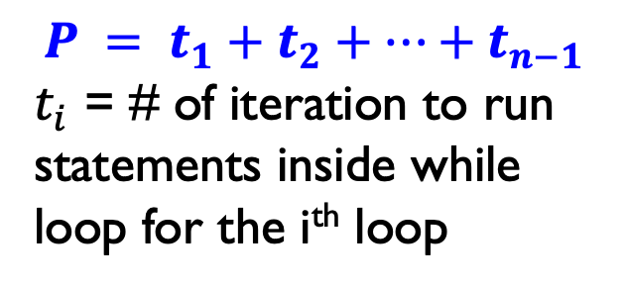
Insertion Sort – Analysis
Statement Effort
InsertionSort(A, n) {
for i = 1 to n-1 {
key = A[i]
j = i - 1;
while (j >= 0) and (A[j] > key) {
A[j+1] = A[j]
j = j - 1
}
A[j+1] = key
}
}
$$P = t_{1}+t_{2}+…+t_{n−1}$$
$t_{i}$ = # of iteration to run statements inside while loop for the i^{th} loop

Slide 47
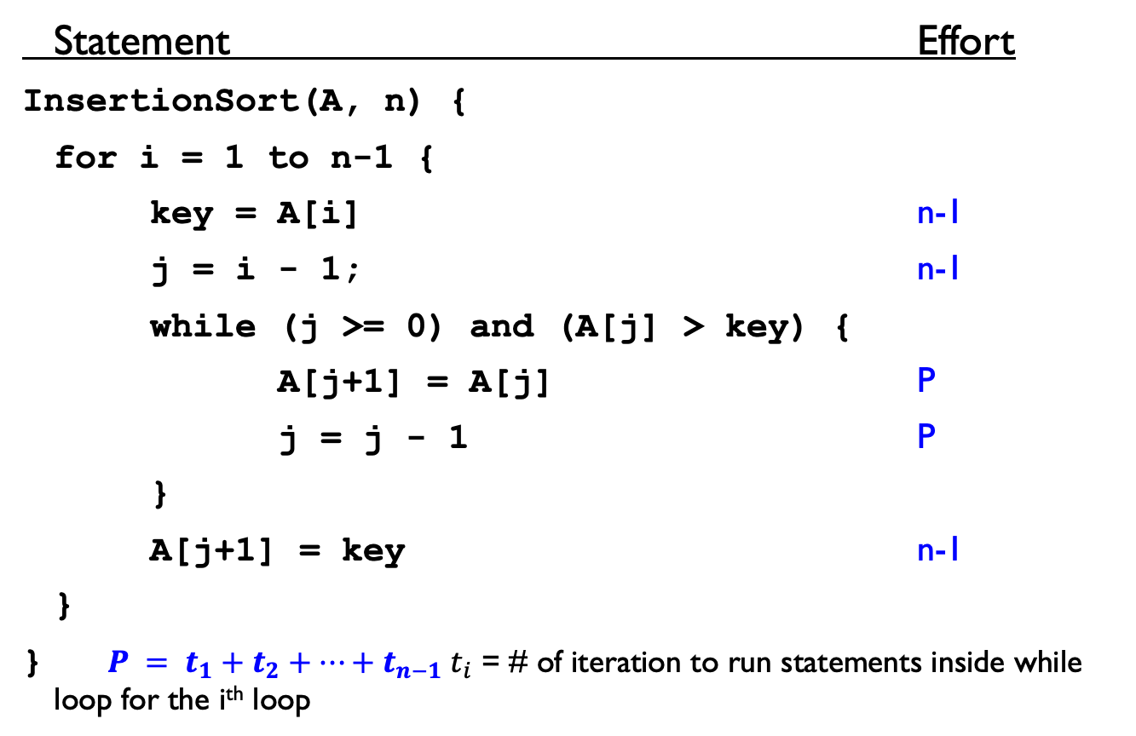
Insertion Sort – Analysis
Statement Effort
InsertionSort(A, n) {
for i = 1 to n-1 {
key = A[i] n-1
j = i - 1; n-1
while (j >= 0) and (A[j] > key) {
A[j+1] = A[j] P
j = j - 1 P
}
A[j+1] = key n-1
}
} $P = t_{1}+t_{2}+…+t_{n−1} t_{i}$ = # of iteration to run statements inside while loop for the i^{th} loop

Slide 48
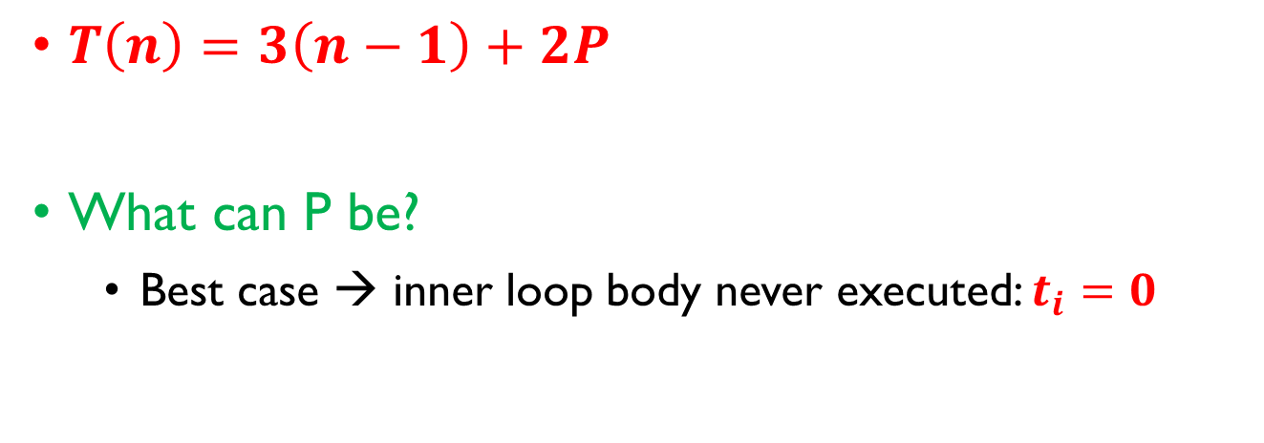
Insertion Sort – Analysis
$T\left(n\right)=3\left(n−1\right)+2P$
What can P be?
Best case → inner loop body never executed: $t_{i}=0$

Slide 49
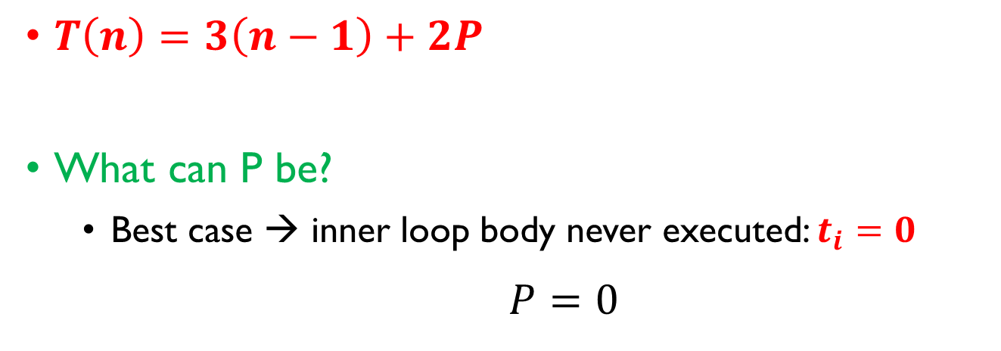
Insertion Sort – Analysis
$T\left(n\right)=3\left(n−1\right)+2P$
What can P be?
Best case → inner loop body never executed: $t_{i}=0$
$P=0$

Slide 50

Insertion Sort – Analysis
$T\left(n\right)=3\left(n−1\right)+2P$
What can P be?
Best case → inner loop body never executed: $t_{i}=0$
$P=0$
$$T\left(n\right)=3\left(n−1\right)$$

Slide 51

Insertion Sort – Analysis
$T\left(n\right)=3\left(n−1\right)+2P$
What can P be?
Best case → inner loop body never executed: $t_{i}=0$
$P=0$
$$T\left(n\right)=3\left(n−1\right)$$
T(n) is a linear function

Slide 52
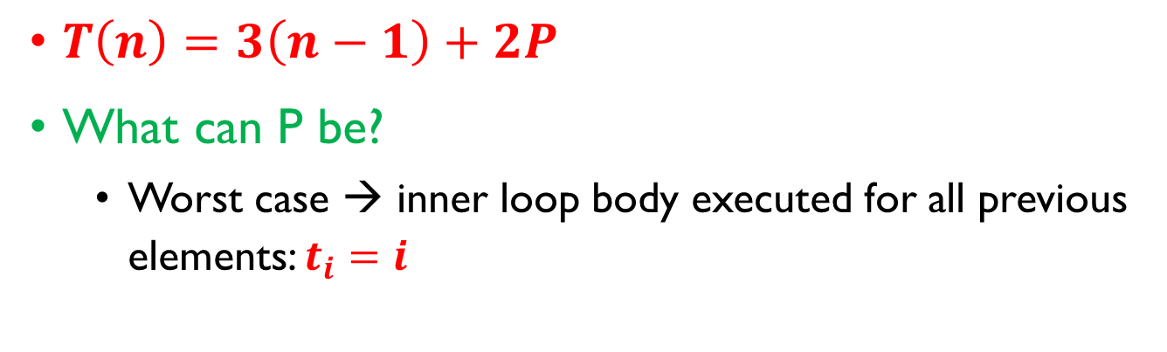
Insertion Sort – Analysis
$T\left(n\right)=3\left(n−1\right)+2P$
What can P be?
Worst case → inner loop body executed for all previous elements: $t_{i}=i$

Slide 53
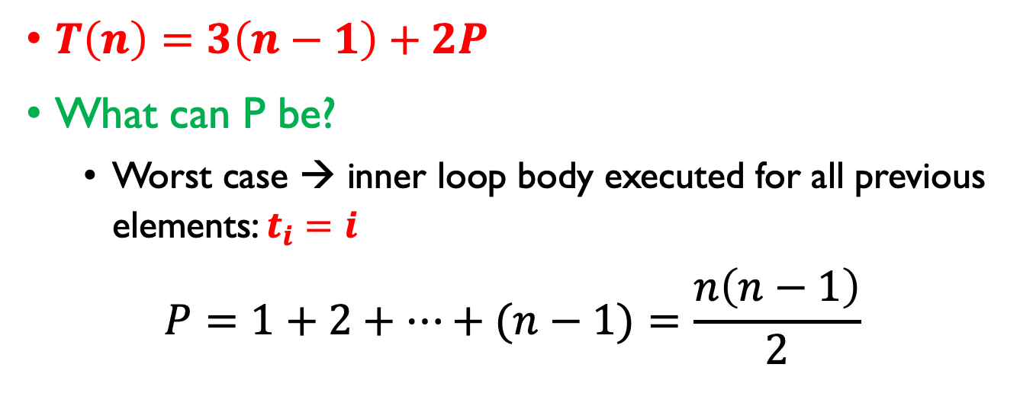
Insertion Sort – Analysis
$T\left(n\right)=3\left(n−1\right)+2P$
What can P be?
Worst case → inner loop body executed for all previous elements: $t_{i}=i$
$$P=1+2+…+(n−1)=\frac{n\left(n−1\right)}{2}$$

Slide 54
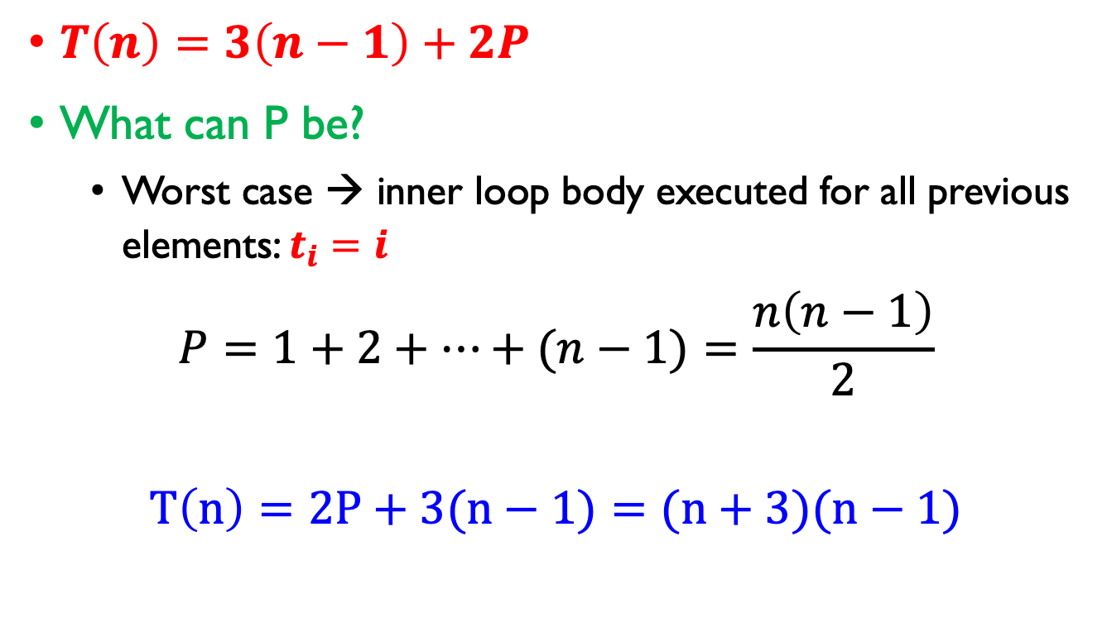
Insertion Sort – Analysis
$T\left(n\right)=3\left(n−1\right)+2P$
What can P be?
Worst case → inner loop body executed for all previous elements: $t_{i}=i$
$$P=1+2+…+(n−1)=\frac{n\left(n−1\right)}{2}$$
$$T\left(n\right)=2P+3(n−1)=(n+3)(n−1)$$

Slide 55
Insertion Sort – Analysis
$T\left(n\right)=3\left(n−1\right)+2P$
What can P be?
Worst case → inner loop body executed for all previous elements: $t_{i}=i$
$$P=1+2+…+(n−1)=\frac{n\left(n−1\right)}{2}$$
$$T\left(n\right)=2P+3(n−1)=(n+3)(n−1)$$
T(n) is a quadratic function

Slide 56
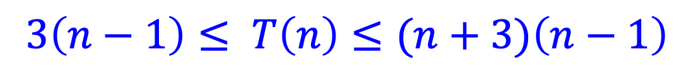
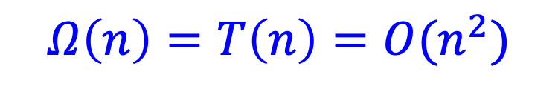
Insertion Sort – Analysis
Asymptotic Notation of T(n)
$$3\left(n−1\right)≤ T\left(n\right)≤(n+3)\left(n−1\right)$$
$$Ω\left(n\right)=T\left(n\right)=O(n^{2})$$
Best case
Worst case

Slide 57
Algorithm Design
There are hosts of algorithm design techniques that have been studied:
divide and conquer
dynamic programming
randomization
greedy algorithms and matroids
transformation to a graph algorithm (network flow, etc.)
optimization algorithms (hill climbing, simulated annealing, etc.)
approximation algorithms
linear programming
heuristic search
genetic algorithms
“software tools”

Slide 58

Divide & Conquer
Divide and Conquer is typically used when there is a large space of possible subproblems, but only a relatively small number are needed
And of those that are needed, each is typically used only once in the solution of the whole problem.

Slide 59
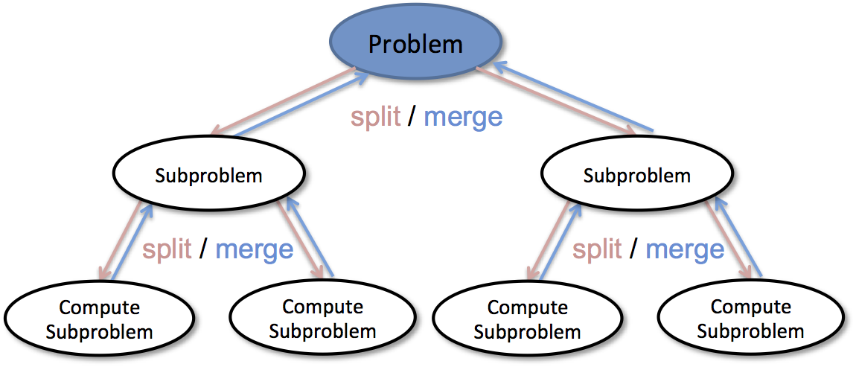
Divide & Conquer
Divide and conquer algorithms are typically recursive programs that work "top down“
Recursively solve a sub-problem whenever the solution to a sub-problem is needed.

Slide 60
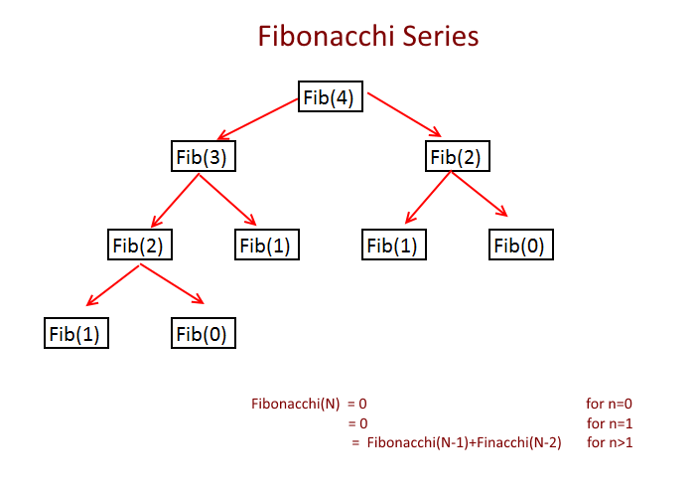
Dynamic Programming
Dynamic programming is typically used when the space of all possible subproblems is relatively small
And it may be that a particular sub-problem is used many times.

Slide 61
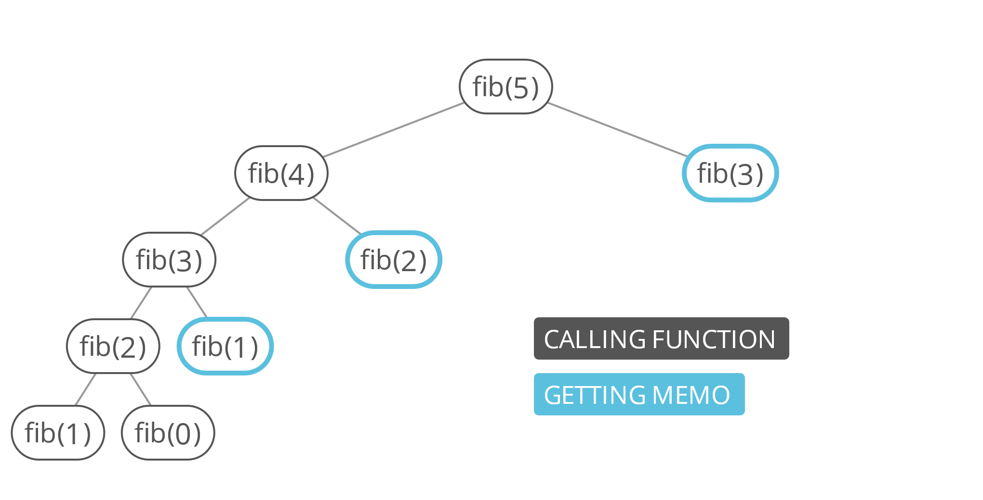
Dynamic Programming
Dynamic programming algorithms typically work iteratively "bottom up" to store the solution to all sub-problems in a table
Where solutions to larger sub-problems make use of already computed solutions to smaller problems.

Slide 62
Divide & Conquer v.s Dynamic Programming
Divide and conquer differs from dynamic programming in the way in which subproblems are computed.
Divide & Conquer | Dynamic Programming
Break down the problem into smaller pieces and then solve each one separately and independently. | Break down the problem into smaller pieces and then solve each one together. The results of each smaller problem need storage.
Each sub-problem is used only once. | A particular sub-problem is used many times.

Slide 63
Divide and Conquer

Slide 64
Divide & Conquer
Idea:
Divide a large problem into a number of smaller problems of the same type.
Solve the smaller problems (recursively).
Combine solutions to the smaller problems into a solution to the original problem.
Examples
Binary Search: A "degenerate" case where the original problem is "divided" into only one smaller problem (finding an item in a list of nl2 items)

Slide 65
Divide & Conquer
Idea:
Divide a large problem into a number of smaller problems of the same type.
Solve the smaller problems (recursively).
Combine solutions to the smaller problems into a solution to the original problem.
Examples
Binary Search: A "degenerate" case where the original problem is "divided" into only one smaller problem (finding an item in a list of nl2 items)

Slide 66
Divide & Conquer
Idea:
Divide a large problem into a number of smaller problems of the same type.
Solve the smaller problems (recursively).
Combine solutions to the smaller problems into a solution to the original problem.
Examples
Binary Search: A "degenerate" case where the original problem is "divided" into only one smaller problem (finding an item in a list of nl2 items)

Slide 67
Divide & Conquer
Idea:
Divide a large problem into a number of smaller problems of the same type.
Solve the smaller problems (recursively).
Combine solutions to the smaller problems into a solution to the original problem.
Examples
Binary Search: A "degenerate" case where the original problem is "divided" into only one smaller problem (finding an item in a list of nl2 items)

Slide 68
Divide & Conquer: Balanced Sub-problems
Important: The smaller problems should be of approximately the same size.
(Bad) example: The following algorithm for sorting a list is just tail recursion that essentially performs an insertion sort in O(n²) time
Divide the list into its first element and the remaining (n-1) elements.
Sort the (n-1) elements recursively.
Insert the first element into this sorted list.

Slide 69
Divide & Conquer: Balanced Sub-problems
Important: The smaller problems should be of approximately the same size.
(Bad) example: The following algorithm for sorting a list is just tail recursion that essentially performs an insertion sort in O(n²) time
Divide the list into its first element and the remaining (n-1) elements.
Sort the (n-1) elements recursively.
Insert the first element into this sorted list.

Slide 70
Merge Sort

Slide 71
Mergesort Example
Divide it in two at the midpoint
Conquer each side in turn (by recursively sorting)
Merge two halves together
8
2
9
4
5
3
1
6

Slide 72
Mergesort Example
8
2
9
4
5
3
1
6
Divide
8 2 9 4
5 3 1 6

Slide 73
Mergesort Example
8
2
9
4
5
3
1
6
Divide
8 2 9 4
5 3 1 6
Divide
8 2
9 4
5 3
1 6

Slide 74
Mergesort Example
8
2
9
4
5
3
1
6
Divide
8 2 9 4
5 3 1 6
Divide
8 2
9 4
5 3
1 6
Divide
1 element
8 2 9 4 5 3 1 6

Slide 75
Mergesort Example
8
2
9
4
5
3
1
6
Divide
8 2 9 4
5 3 1 6
Divide
8 2
9 4
5 3
1 6
Divide
1 element
8 2 9 4 5 3 1 6
Merge
2 8 4 9 3 5 1 6

Slide 76
Mergesort Example
8
2
9
4
5
3
1
6
Divide
8 2 9 4
5 3 1 6
Divide
8 2
9 4
5 3
1 6
Divide
1 element
8 2 9 4 5 3 1 6
Merge
2 8 4 9 3 5 1 6
Merge
2 4 8 9 1 3 5 6

Slide 77
Mergesort Example
8
2
9
4
5
3
1
6
Divide
8 2 9 4
5 3 1 6
Divide
8 2
9 4
5 3
1 6
Divide
1 element
8 2 9 4 5 3 1 6
Merge
2 8 4 9 3 5 1 6
Merge
2 4 8 9 1 3 5 6
Merge
1 2 3 4 5 6 8 9

Slide 78
Merging Step (Details)
The merging requires an auxiliary array.
2
4
8
9
1
3
5
6
1
Auxiliary array

Slide 79
Merging Step (Details)
The merging requires an auxiliary array.
2
4
8
9
1
3
5
6
1
2
Auxiliary array

Slide 80
Merging Step (Details)
The merging requires an auxiliary array.
2
4
8
9
1
3
5
6
1
2
3
Auxiliary array

Slide 81
Merging Step (Details)
The merging requires an auxiliary array.
2
4
8
9
1
3
5
6
1
2
3
4
Auxiliary array

Slide 82
Merging Step (Details)
The merging requires an auxiliary array.
2
4
8
9
1
3
5
6
1
2
3
4
5
Auxiliary array

Slide 83
Merging Step (Details)
The merging requires an auxiliary array.
2
4
8
9
1
3
5
6
1
2
3
4
5
6
Auxiliary array

Slide 84
Merging Step (Details)
The merging requires an auxiliary array.
2
4
8
9
1
3
5
6
1
2
3
4
5
6
8
Auxiliary array

Slide 85
Merging Step (Details)
The merging requires an auxiliary array.
2
4
8
9
1
3
5
6
1
2
3
4
5
6
8
9
Auxiliary array
In the worst case, how many comparisons are needed in total
when merging two arrays of N/2 elements?
Answer: N

Slide 86
Merge Sort – Implementation
MergeSort(A, left, right) {
if (left < right) {
mid = floor((left + right) / 2);
MergeSort(A, left, mid);
MergeSort(A, mid+1, right);
Merge(A, left, mid, right);
}
}
Merge()
Takes two sorted subarrays of A
Merges them into a single sorted subarray of A
How long should this take?

Slide 87
Merge Sort – Implementation
MergeSort(A, left, right) {
if (left < right) {
mid = floor((left + right) / 2);
MergeSort(A, left, mid);
MergeSort(A, mid+1, right);
Merge(A, left, mid, right);
}
}
Merge()
Takes two sorted subarrays of A
Merges them into a single sorted subarray of A
How long should this take?

Slide 88

Merge Sort – Merge()
How do we merge two subarrays
$$[3 4 8 12] \& [2 3 5 7]$$
What is the complexity of Merge()?

Slide 89

Merge Sort – Merge()
How do we merge two subarrays
$$[3 4 8 12] \& [2 3 5 7]$$
What is the complexity of Merge()?

Slide 90
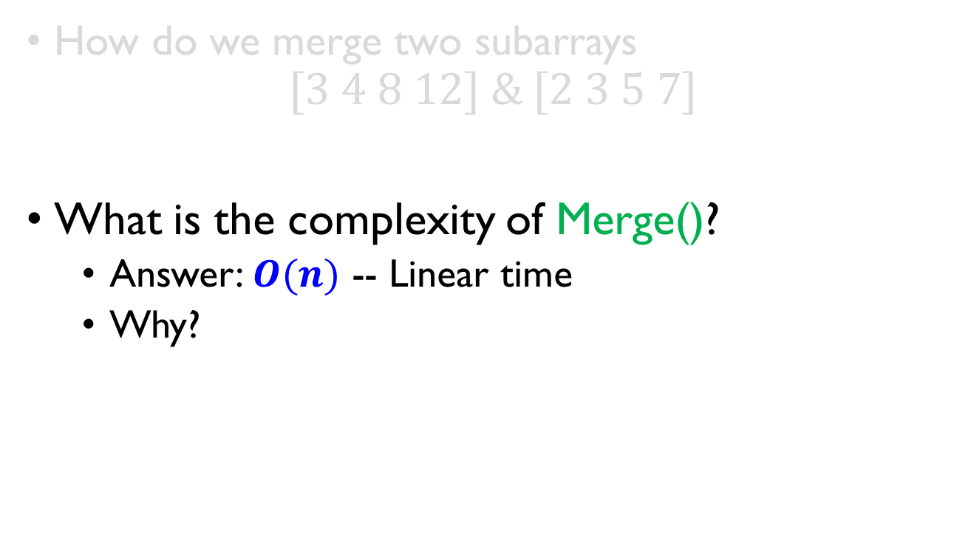
Merge Sort – Merge()
How do we merge two subarrays
$$[3 4 8 12] \& [2 3 5 7]$$
What is the complexity of Merge()?
Answer: $O(n)$ -- Linear time
Why?
In the worst case, N comparisons are needed in total
when merging two arrays of N/2 elements

Slide 91
Merge Sort Pseudo Code
mergeSort(arr):
sorted_arr = arr // let sorted array with the same data structure as the input array
if len(arr) > 1:
r = len(arr)//2
leftArr = arr[:r]
rightArr = arr[r:]
mergeSort(leftArr)
mergeSort(rightArr)
i = j = k = 0
do_merge_step(leftArr, rightArr, i, j, k)
return sorted_arr

Slide 92
Merge Sort Pseudo Code
do_merge_step(leftArr, rightArr, i, j, k):
while i < len(leftArr) and j < len(rightArr):
if leftArr[i] < rightArr[j]:
sorted_arr [k] = leftArr[i]
i += 1
else:
sorted_arr [k] = rightArr[j]
j += 1
k += 1
while i < len(leftArr):
sorted_arr [k] = leftArr[i] i += 1 k += 1
while j < len(rightArr):
sorted_arr [k] = rightArr[j] j += 1 k += 1

Slide 93
Merge Sort Complexity Analysis
Let T(N) be the running time for an array of N elements
How to find estimate T(N) ?
We need to discover the Recurrence Relation between T(N) and T(N/2).
Notes:
Mergesort divides array in half and calls itself on the two halves. After returning, it merges both halves using a temporary array
Each recursive call takes T(N/2) and merging takes O(N)

Slide 94

Merge Sort – Analysis
Statement Effort
$T\left(n\right)=1$ when $n=1$
$T\left(n\right)=2T\left(\frac{n}{2}\right)+n$ when $n > 1$
MergeSort(A, left, right) { T(n)
if (left < right) { 1
mid = floor((left + right) / 2); 1
MergeSort(A, left, mid); T(n/2)
MergeSort(A, mid+1, right); T(n/2)
Merge(A, left, mid, right); n
}
}
index

Slide 95

Merge Sort – Analysis
Statement Time cost
$T\left(n\right)=1$ when $n=1$
$T\left(n\right)=2T\left(\frac{n}{2}\right)+n$ when $n > 1$
MergeSort(A, left, right) { T(n)
if (left < right) { 1
mid = floor((left + right) / 2); 1
MergeSort(A, left, mid); T(n/2)
MergeSort(A, mid+1, right); T(n/2)
Merge(A, left, mid, right); n
}
}

Slide 96

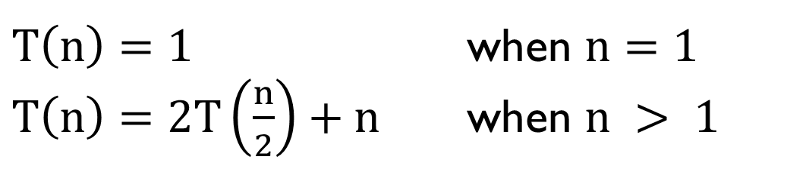

Merge Sort – Analysis
$T\left(n\right)=1$ when $n=1$
$T\left(n\right)=2T\left(\frac{n}{2}\right)+n$ when $n > 1$
Iteration
method
Master
theorem
$$T\left(n\right)=O(n×\log_{2}{n})$$
Merge Sort is $O(n\log{n})$ guaranteed

Slide 97
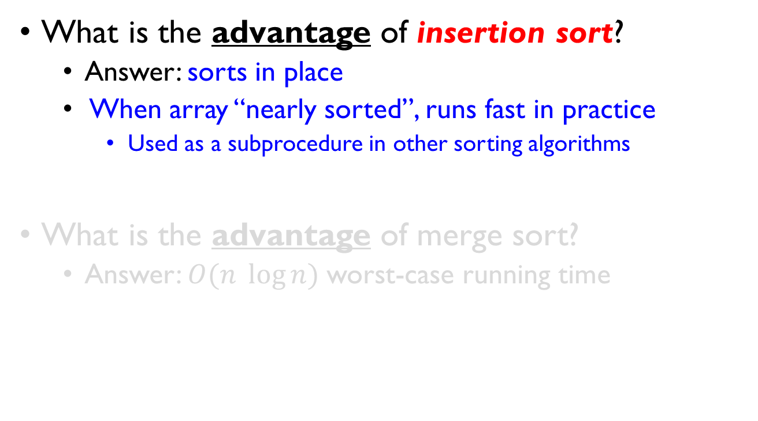
Sorting Revisited
What is the advantage of insertion sort?
Answer: sorts in place
When array “nearly sorted”, runs fast in practice
Used as a subprocedure in other sorting algorithms
What is the advantage of merge sort?
Answer: $O(n \log{n})$ worst-case running time

Slide 98
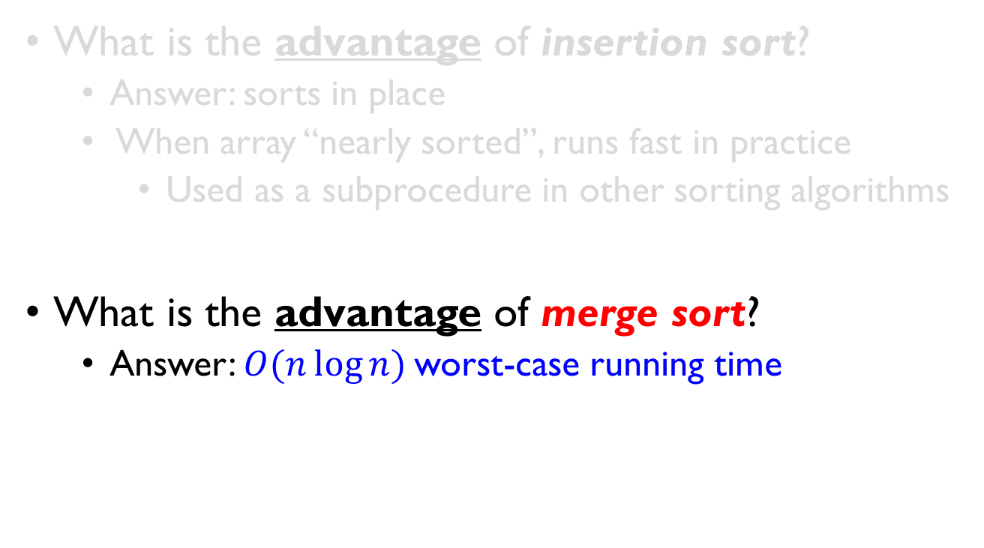
Sorting Revisited
What is the advantage of insertion sort?
Answer: sorts in place
When array “nearly sorted”, runs fast in practice
Used as a subprocedure in other sorting algorithms
What is the advantage of merge sort?
Answer: $O(n\log{n})$worst-case running time

Slide 99
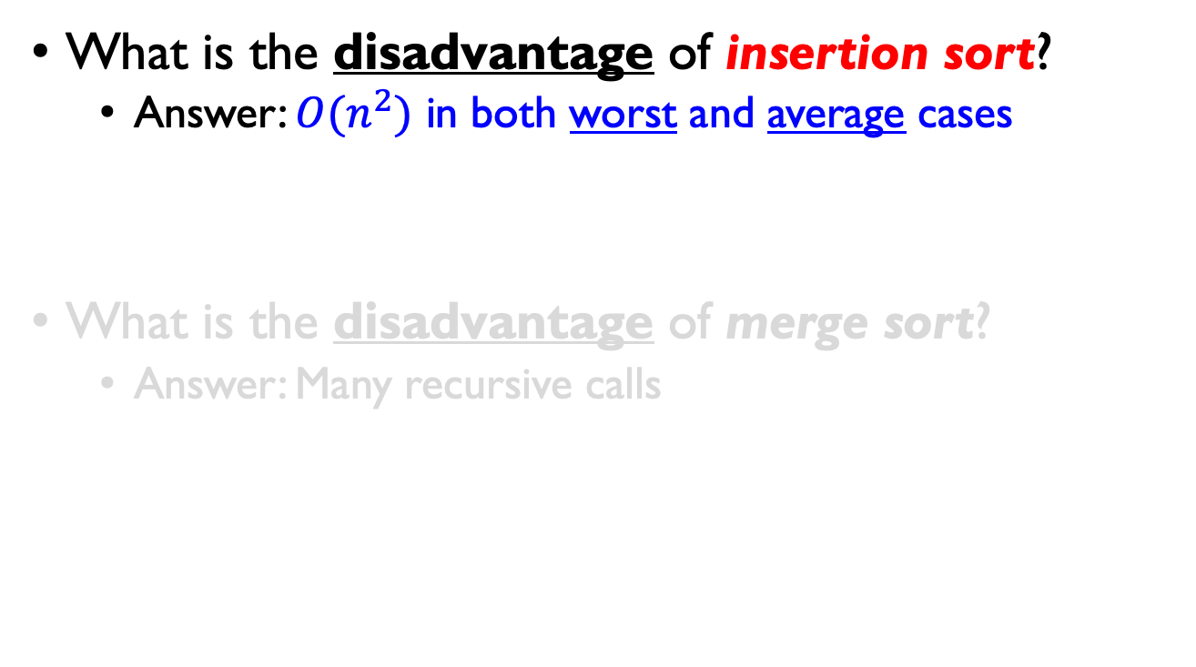
Sorting Revisited
What is the disadvantage of insertion sort?
Answer: $O(n^{2})$ in both worst and average cases
What is the disadvantage of merge sort?
Answer: Many recursive calls

Slide 100
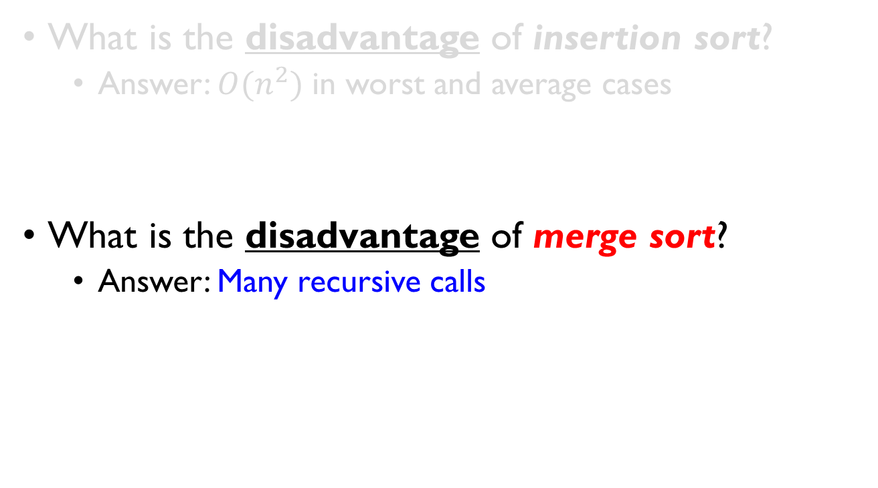
Sorting Revisited
What is the disadvantage of insertion sort?
Answer: $O(n^{2})$ in worst and average cases
What is the disadvantage of merge sort?
Answer: Many recursive calls

Slide 101
Quick Sort

Slide 102
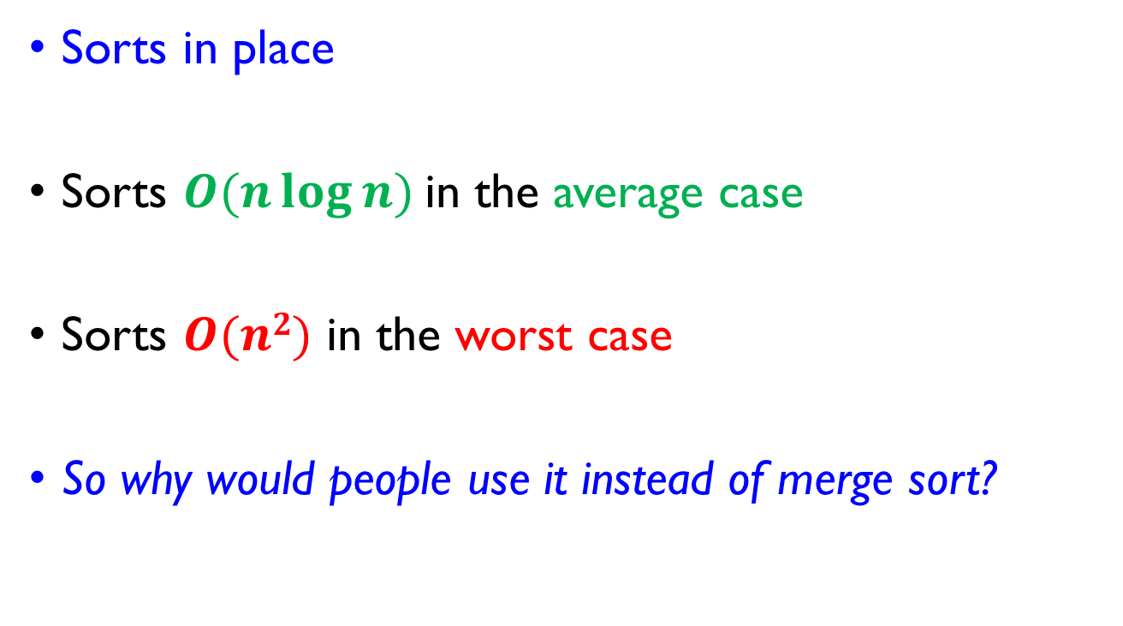
Quick Sort
Sorts in place
Sorts $O(n\log{n})$in the average case
Sorts $O(n2)$ in the worst case
So why would people use it instead of merge sort?

Slide 103
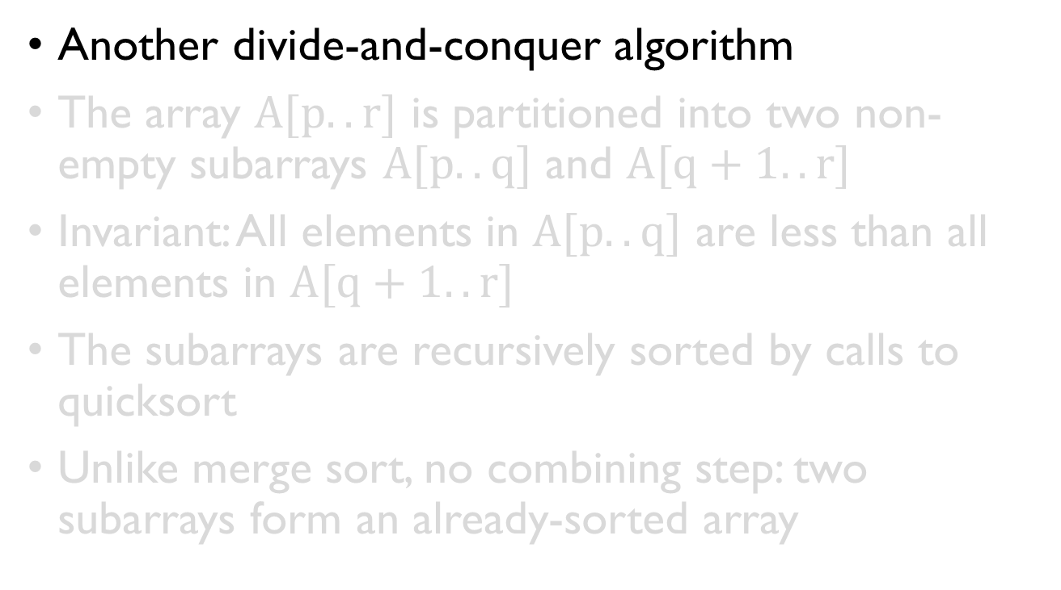
Quick Sort
Another divide-and-conquer algorithm
The array $A[p..r]$ is partitioned into two non-empty subarrays $A[p..q]$ and $A[q+1..r]$
Invariant: All elements in $A[p..q]$ are less than all elements in $A[q+1..r]$
The subarrays are recursively sorted by calls to quicksort
Unlike merge sort, no combining step: two subarrays form an already-sorted array

Slide 104
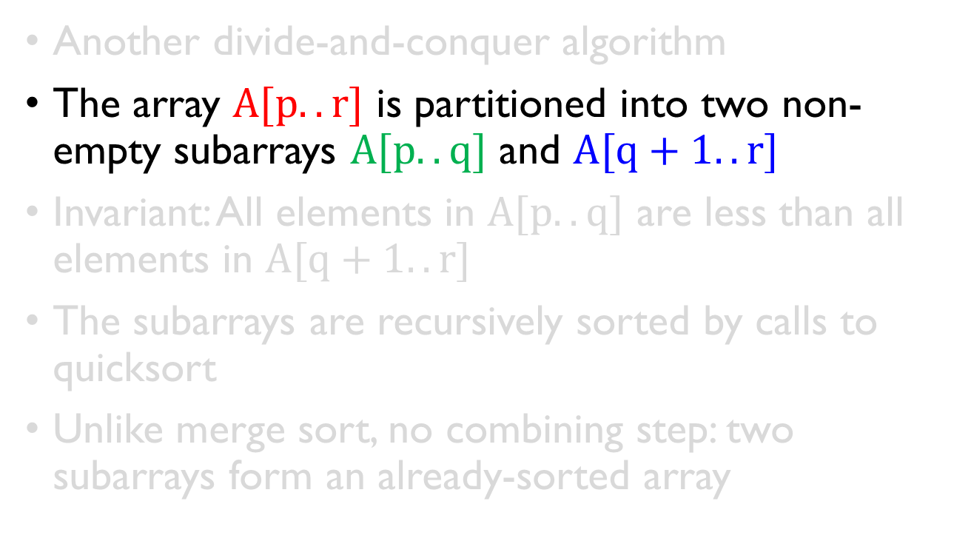
Quick Sort
Another divide-and-conquer algorithm
The array $A[p..r]$ is partitioned into two non-empty subarrays $A[p..q]$ and $A[q+1..r]$
Invariant: All elements in $A[p..q]$ are less than all elements in $A[q+1..r]$
The subarrays are recursively sorted by calls to quicksort
Unlike merge sort, no combining step: two subarrays form an already-sorted array

Slide 105
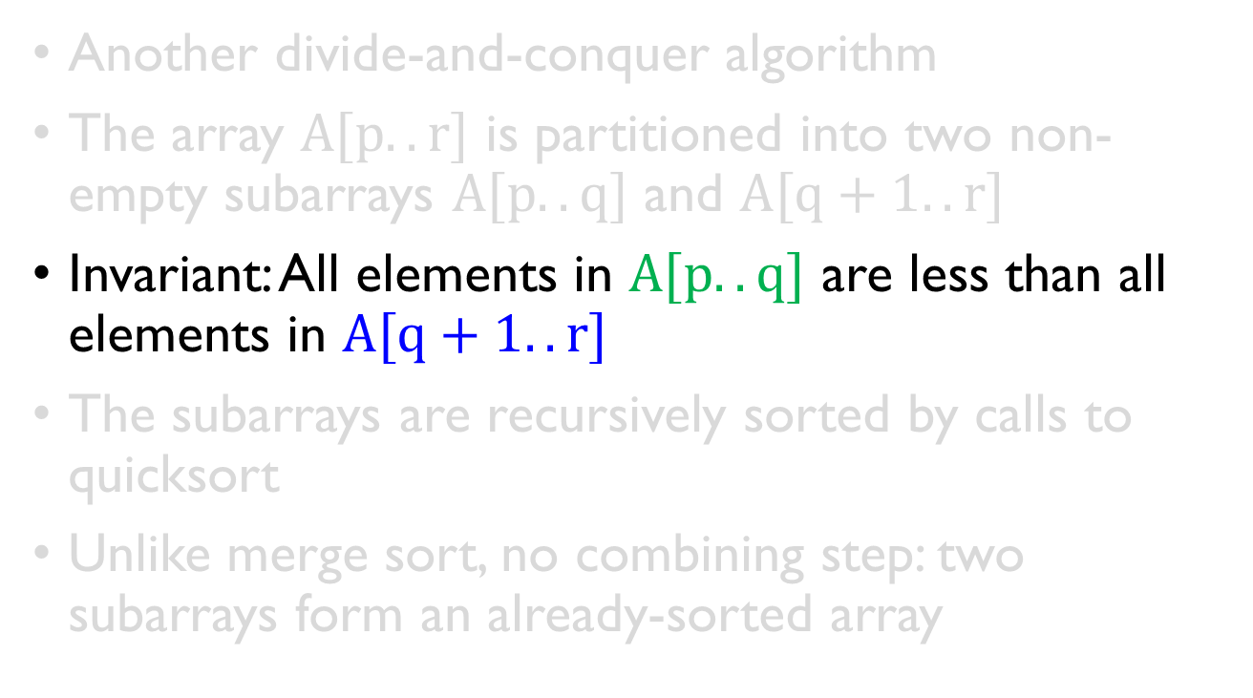
Quick Sort
Another divide-and-conquer algorithm
The array $A[p..r]$ is partitioned into two non-empty subarrays $A[p..q]$ and $A[q+1..r]$
Invariant: All elements in $A[p..q]$ are less than all elements in $A[q+1..r]$
The subarrays are recursively sorted by calls to quicksort
Unlike merge sort, no combining step: two subarrays form an already-sorted array

Slide 106
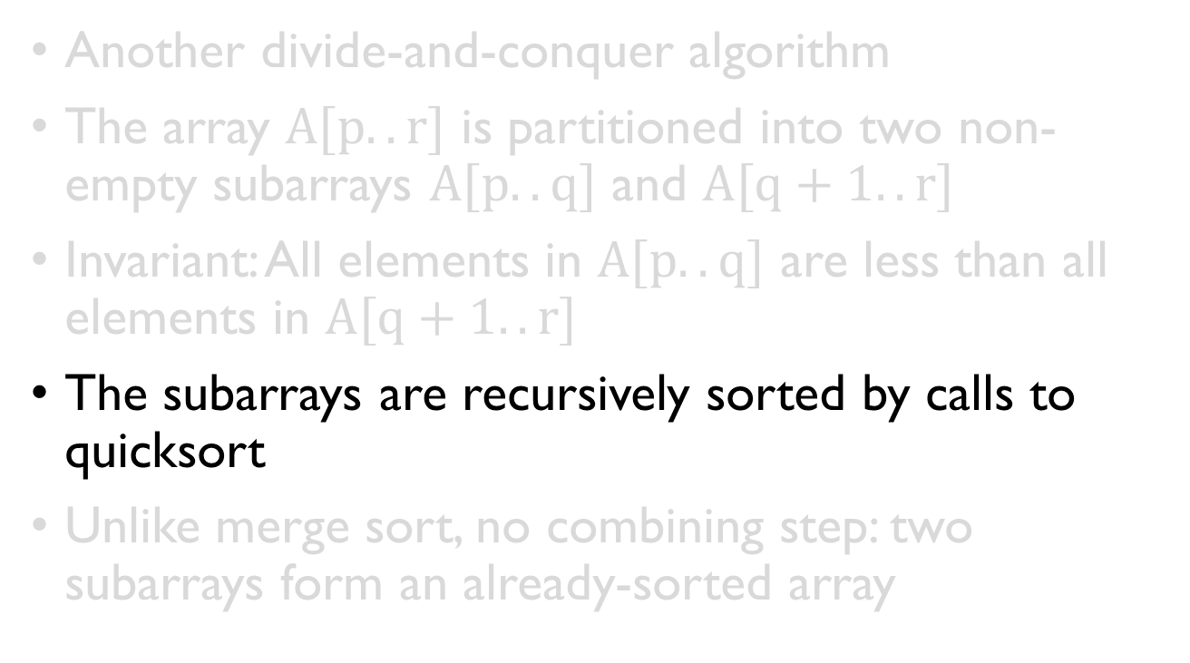
Quick Sort
Another divide-and-conquer algorithm
The array $A[p..r]$ is partitioned into two non-empty subarrays $A[p..q]$ and $A[q+1..r]$
Invariant: All elements in $A[p..q]$ are less than all elements in $A[q+1..r]$
The subarrays are recursively sorted by calls to quicksort
Unlike merge sort, no combining step: two subarrays form an already-sorted array

Slide 107

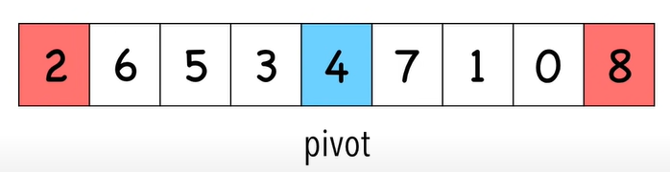

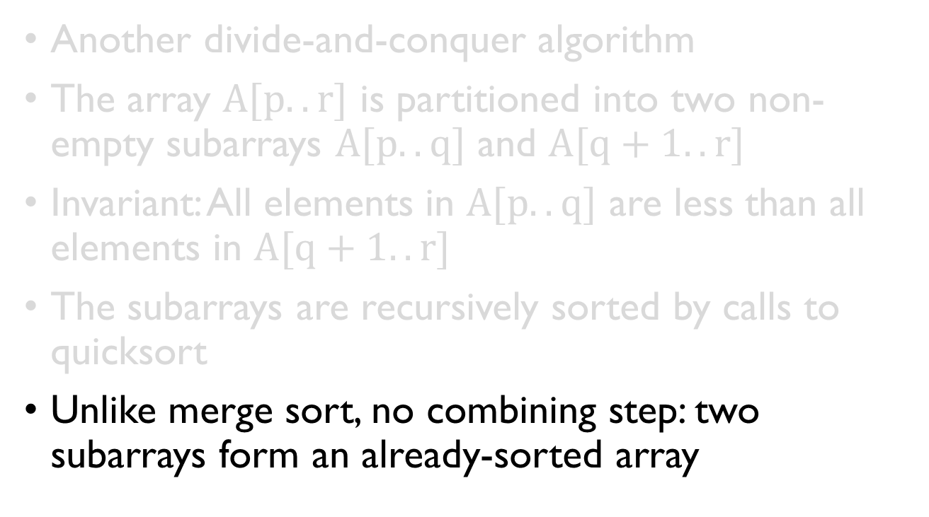
Quick Sort
Another divide-and-conquer algorithm
The array $A[p..r]$ is partitioned into two non-empty subarrays $A[p..q]$ and $A[q+1..r]$
Invariant: All elements in $A[p..q]$ are less than all elements in $A[q+1..r]$
The subarrays are recursively sorted by calls to quicksort
Unlike merge sort, no combining step: two subarrays form an already-sorted array

Slide 108
Quick Sort
Quicksort(A, p, r) {
if (p < r) {
q = Partition(A, p, r);
Quicksort(A, p, q);
Quicksort(A, q+1, r);
}
}

Slide 109
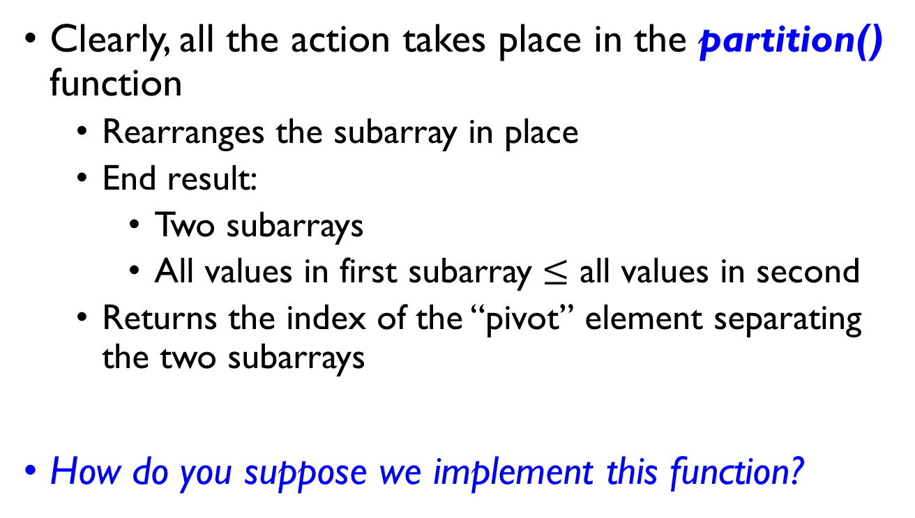
Quick Sort – Partition()
Clearly, all the action takes place in the partition() function
Rearranges the subarray in place
End result:
Two subarrays
All values in first subarray $≤$ all values in second
Returns the index of the “pivot” element separating the two subarrays
How do you suppose we implement this function?

Slide 110
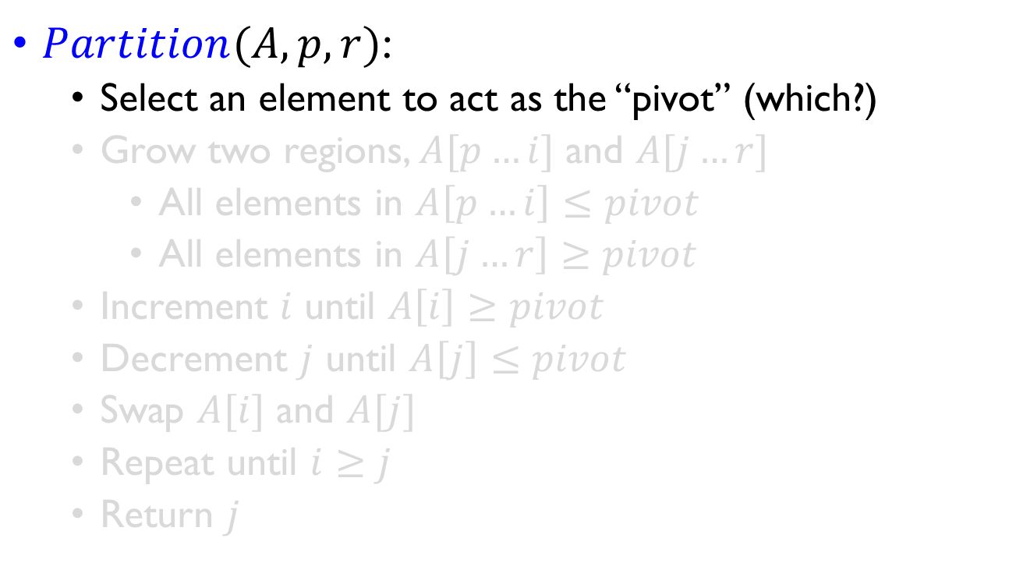
Quick Sort – Partition()
$Partition(A, p, r)$:
Select an element to act as the “pivot” (which?)
Grow two regions, $A[p…i]$ and $A[j…r]$
All elements in $A\left[p…i\right]≤pivot$
All elements in $A\left[j…r\right]≥pivot$
Increment $i$ until $A\left[i\right]≥pivot$
Decrement $j$ until $A\left[j\right]≤pivot$
Swap $A[i]$ and $A[j]$
Repeat until $i≥j$
Return $j$

Slide 111
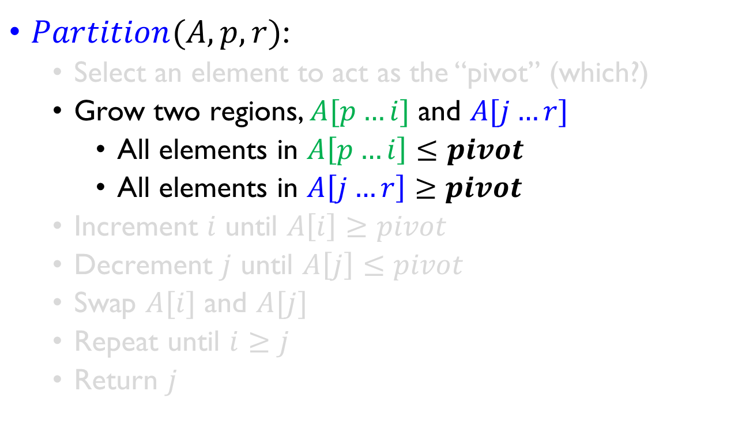
Quick Sort – Partition()
$Partition(A, p, r)$:
Select an element to act as the “pivot” (which?)
Grow two regions, $A[p…i]$ and $A[j…r]$
All elements in $A\left[p…i\right]≤pivot$
All elements in $A\left[j…r\right]≥pivot$
Increment $i$ until $A\left[i\right]≥pivot$
Decrement $j$ until $A\left[j\right]≤pivot$
Swap $A[i]$ and $A[j]$
Repeat until $i≥j$
Return $j$

Slide 112
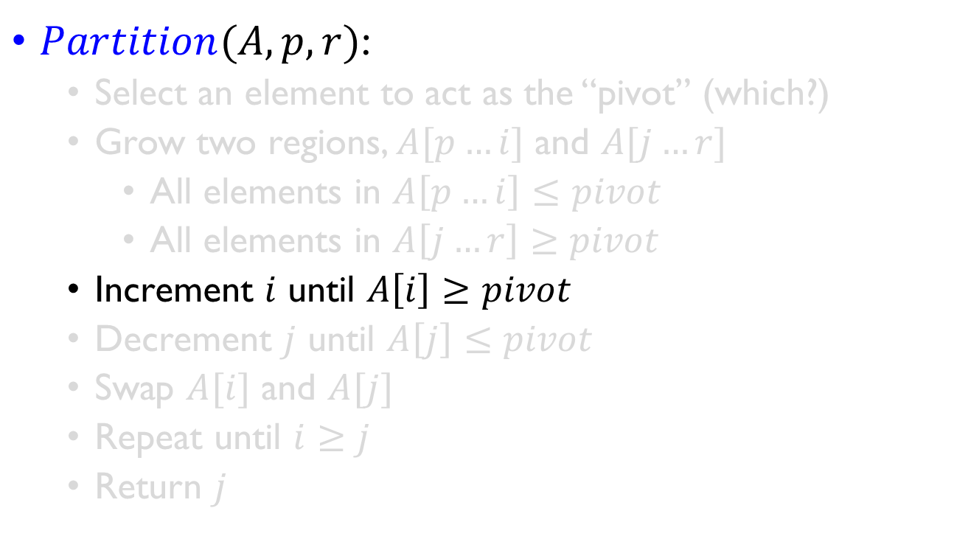
Quick Sort – Partition()
$Partition(A, p, r)$:
Select an element to act as the “pivot” (which?)
Grow two regions, $A[p…i]$ and $A[j…r]$
All elements in $A\left[p…i\right]≤pivot$
All elements in $A\left[j…r\right]≥pivot$
Increment $i$ until $A\left[i\right]≥pivot$
Decrement $j$ until $A\left[j\right]≤pivot$
Swap $A[i]$ and $A[j]$
Repeat until $i≥j$
Return $j$

Slide 113
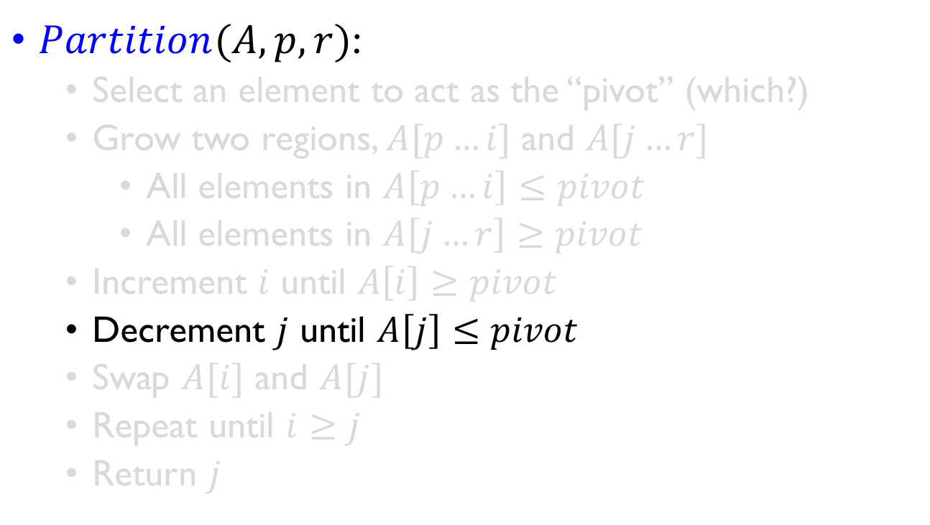
Quick Sort – Partition()
$Partition(A, p, r)$:
Select an element to act as the “pivot” (which?)
Grow two regions, $A[p…i]$ and $A[j…r]$
All elements in $A\left[p…i\right]≤pivot$
All elements in $A\left[j…r\right]≥pivot$
Increment $i$ until $A\left[i\right]≥pivot$
Decrement $j$ until $A\left[j\right]≤pivot$
Swap $A[i]$ and $A[j]$
Repeat until $i≥j$
Return $j$

Slide 114
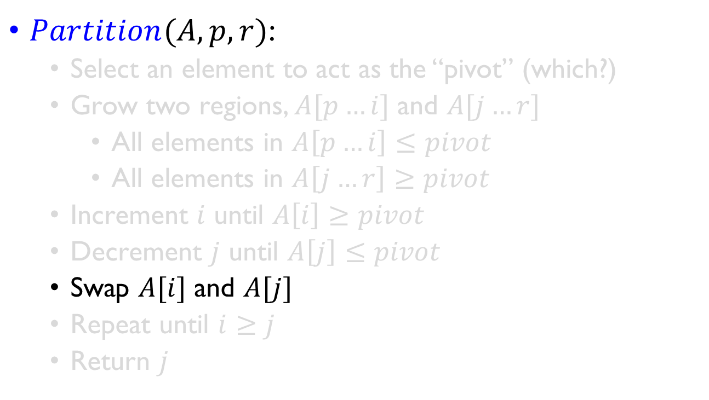
Quick Sort – Partition()
$Partition(A, p, r)$:
Select an element to act as the “pivot” (which?)
Grow two regions, $A[p…i]$ and $A[j…r]$
All elements in $A\left[p…i\right]≤pivot$
All elements in $A\left[j…r\right]≥pivot$
Increment $i$ until $A\left[i\right]≥pivot$
Decrement $j$ until $A\left[j\right]≤pivot$
Swap $A[i]$ and $A[j]$
Repeat until $i≥j$
Return $j$

Slide 115
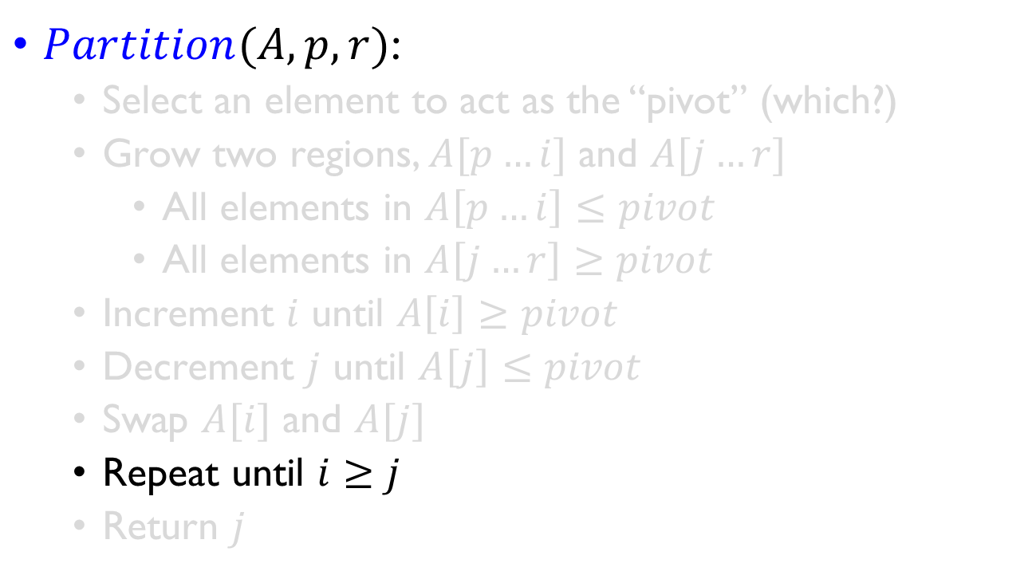
Quick Sort – Partition()
$Partition(A, p, r)$:
Select an element to act as the “pivot” (which?)
Grow two regions, $A[p…i]$ and $A[j…r]$
All elements in $A\left[p…i\right]≤pivot$
All elements in $A\left[j…r\right]≥pivot$
Increment $i$ until $A\left[i\right]≥pivot$
Decrement $j$ until $A\left[j\right]≤pivot$
Swap $A[i]$ and $A[j]$
Repeat until $i≥j$
Return $j$

Slide 116
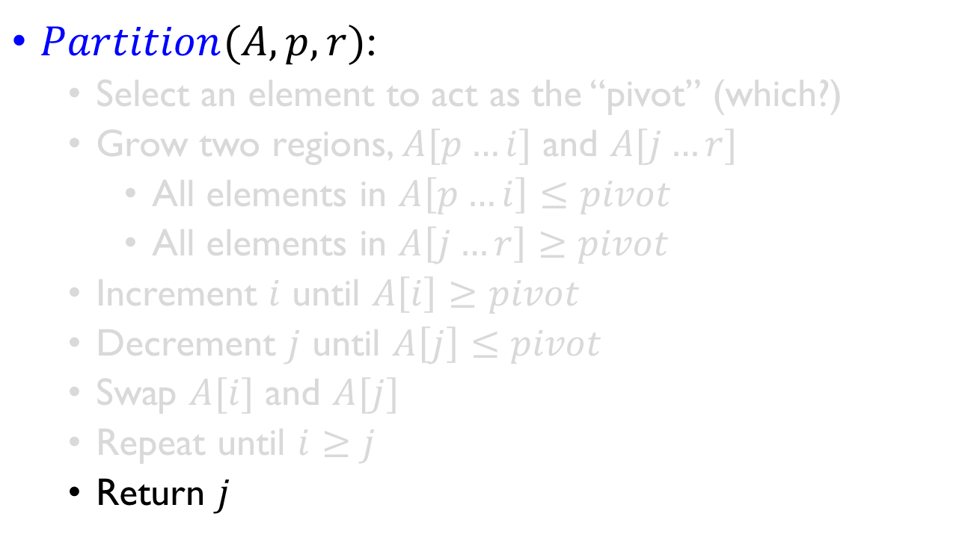
Quick Sort – Partition()
$Partition(A, p, r)$:
Select an element to act as the “pivot” (which?)
Grow two regions, $A[p…i]$ and $A[j…r]$
All elements in $A\left[p…i\right]≤pivot$
All elements in $A\left[j…r\right]≥pivot$
Increment $i$ until $A\left[i\right]≥pivot$
Decrement $j$ until $A\left[j\right]≤pivot$
Swap $A[i]$ and $A[j]$
Repeat until $i≥j$
Return $j$

Slide 117
Quick Sort – Partition()
Partition(A, p, r)
x = A[p];
i = p - 1;
j = r + 1;
while (TRUE)
repeat
j--;
until A[j] <= x;
repeat
i++;
until A[i] >= x;
if (i < j)
Swap(A, i, j);
else
return j;
Illustrate on A = {5, 3, 2, 6, 4, 1, 3, 7};

Slide 118
Quick Sort – Partition() Illustration
index | 1 | 2 | 3 | 4 | 5 | 6 | 7 | 8
value | 5 | 3 | 2 | 6 | 4 | 1 | 3 | 7
A
Partition(A, p, r)
x = A[p]; // x=A[1]=5
i = p - 1; // i=0
j = r + 1; // j=9
while (TRUE)
repeat
j--;
until A[j] <= x;
repeat
i++;
until A[i] >= x;
if (i < j)
Swap(A, i, j);
else
return j;

Slide 119
Quick Sort – Partition() Illustration
index | 1 | 2 | 3 | 4 | 5 | 6 | 7 | 8
value | 5 | 3 | 2 | 6 | 4 | 1 | 3 | 7
A
Partition(A, p, r)
x = A[p]; // x=A[1]=5
i = p - 1; // i=0
j = r + 1; // j=9
while (TRUE)
repeat
j--; // j<- 8,7
until A[j] <= x;
repeat
i++;
until A[i] >= x;
if (i < j)
Swap(A, i, j);
else
return j;

Slide 120
Quick Sort – Partition() Illustration
index | 1 | 2 | 3 | 4 | 5 | 6 | 7 | 8
value | 5 | 3 | 2 | 6 | 4 | 1 | 3 | 7
A
Partition(A, p, r)
x = A[p]; // x=A[1]=5
i = p - 1; // i=0
j = r + 1; // j=9
while (TRUE)
repeat
j--; // j<- 7
until A[j] <= x;
repeat
i++; // i<- 1
until A[i] >= x;
if (i < j)
Swap(A, i, j);
else
return j;

Slide 121
Quick Sort – Partition() Illustration
A
index | 1 | 2 | 3 | 4 | 5 | 6 | 7 | 8
value | 5 | 3 | 2 | 6 | 4 | 1 | 3 | 7
Partition(A, p, r)
x = A[p]; // x=A[1]=5
i = p - 1; // i=0
j = r + 1; // j=9
while (TRUE)
repeat
j--; // j<- 7
until A[j] <= x;
repeat
i++; // i<- 1
until A[i] >= x;
if (i < j)
Swap(A, i, j);
else
return j;

Slide 122
Quick Sort – Partition() Illustration
A
index | 1 | 2 | 3 | 4 | 5 | 6 | 7 | 8
value | 3 | 3 | 2 | 6 | 4 | 1 | 5 | 7
Partition(A, p, r)
x = A[p]; // x=A[1]=5
i = p - 1; // i=0
j = r + 1; // j=9
while (TRUE)
repeat
j--; // j<- 7
until A[j] <= x;
repeat
i++; // i<- 1
until A[i] >= x;
if (i < j)
Swap(A, i, j);
else
return j;

Slide 123
Quick Sort – Partition() Illustration
A
index | 1 | 2 | 3 | 4 | 5 | 6 | 7 | 8
value | 3 | 3 | 2 | 6 | 4 | 1 | 5 | 7
Partition(A, p, r)
x = A[p]; // x=A[1]=5
i = p - 1; // i=0
j = r + 1; // j=9
while (TRUE)
repeat
j--; // j<- 6
until A[j] <= x;
repeat
i++; // i<- 1
until A[i] >= x;
if (i < j)
Swap(A, i, j);
else
return j;

Slide 124
Quick Sort – Partition() Illustration
A
index | 1 | 2 | 3 | 4 | 5 | 6 | 7 | 8
value | 3 | 3 | 2 | 6 | 4 | 1 | 5 | 7
Partition(A, p, r)
x = A[p]; // x=A[1]=5
i = p - 1; // i=0
j = r + 1; // j=9
while (TRUE)
repeat
j--; // j<- 6
until A[j] <= x;
repeat
i++;//i<- 2 3 4
until A[i] >= x;
if (i < j)
Swap(A, i, j);
else
return j;

Slide 125
Quick Sort – Partition() Illustration
A
index | 1 | 2 | 3 | 4 | 5 | 6 | 7 | 8
value | 3 | 3 | 2 | 6 | 4 | 1 | 5 | 7
Partition(A, p, r)
x = A[p]; // x=A[1]=5
i = p - 1; // i=0
j = r + 1; // j=9
while (TRUE)
repeat
j--; // j<- 6
until A[j] <= x;
repeat
i++;//i<- 2 3 4
until A[i] >= x;
if (i < j)
Swap(A, i, j);
else
return j;

Slide 126
Quick Sort – Partition() Illustration
A
index | 1 | 2 | 3 | 4 | 5 | 6 | 7 | 8
value | 3 | 3 | 2 | 1 | 4 | 6 | 5 | 7
Partition(A, p, r)
x = A[p]; // x=A[1]=5
i = p - 1; // i=0
j = r + 1; // j=9
while (TRUE)
repeat
j--; // j<- 6
until A[j] <= x;
repeat
i++;//i<- 2 3 4
until A[i] >= x;
if (i < j)
Swap(A, i, j);
else
return j;

Slide 127
Quick Sort – Partition() Illustration
A
index | 1 | 2 | 3 | 4 | 5 | 6 | 7 | 8
value | 3 | 3 | 2 | 1 | 4 | 6 | 5 | 7
Partition(A, p, r)
x = A[p]; // x=A[1]=5
i = p - 1; // i=0
j = r + 1; // j=9
while (TRUE)
repeat
j--; // j<- 5
until A[j] <= x;
repeat
i++;//i<- 2 3 4
until A[i] >= x;
if (i < j)
Swap(A, i, j);
else
return j;

Slide 128
Quick Sort – Partition() Illustration
A
index | 1 | 2 | 3 | 4 | 5 | 6 | 7 | 8
value | 3 | 3 | 2 | 1 | 4 | 6 | 5 | 7
Partition(A, p, r)
x = A[p]; // x=A[1]=5
i = p - 1; // i=0
j = r + 1; // j=9
while (TRUE)
repeat
j--; // j<- 5
until A[j] <= x;
repeat
i++;//i<- 5 6
until A[i] >= x;
if (i < j)
Swap(A, i, j);
else
return j;

Slide 129
Quick Sort – Partition() Illustration
A
index | 1 | 2 | 3 | 4 | 5 | 6 | 7 | 8
value | 3 | 3 | 2 | 1 | 4 | 6 | 5 | 7
Partition(A, p, r)
x = A[p]; // x=A[1]=5
i = p - 1; // i=0
j = r + 1; // j=9
while (TRUE)
repeat
j--; // j<- 5
until A[j] <= x;
repeat
i++;//i<- 5 6
until A[i] >= x;
if (i < j)
Swap(A, i, j);
else
return j; //j=5

Slide 130
Quick Sort – Partition() Illustration
A
index | 1 | 2 | 3 | 4 | 5 | 6 | 7 | 8
value | 3 | 3 | 2 | 1 | 4 | 6 | 5 | 7
Partition(A, p, r)
x = A[p]; // x=A[1]=5
i = p - 1; // i=0
j = r + 1; // j=9
while (TRUE)
repeat
j--; // j<- 5
until A[j] <= x;
repeat
i++;//i<- 5 6
until A[i] >= x;
if (i < j)
Swap(A, i, j);
else
return j; //j=5
Let q = Partition(A, p, r);
A[p..q]<= x;
A[q+1..r]>=x;
x is the pivot here.

Slide 131
Quick Sort – Partition()
What is the running time of partition()?
partition() runs in O(n) time

Slide 132
Quick Sort – Partition()
What is the running time of partition()?
partition() runs in O(n) time
A
index | 1 | 2 | 3 | 4 | 5 | 6 | 7 | 8
value | 3 | 3 | 2 | 1 | 4 | 6 | 5 | 7

Slide 133
Analyzing Quicksort
What will be the worst case for the algorithm?
Partition is always unbalanced
Will any particular input elicit the worst case?
Already-sorted input
What will be the best case for the algorithm?
Partition is perfectly balanced
Notes:
Elicit /ēˈlisət/

Slide 134
Analyzing Quicksort
What will be the worst case for the algorithm?
Partition is always unbalanced
Will any particular input elicit the worst case?
Already-sorted input
What will be the best case for the algorithm?
Partition is perfectly balanced

Slide 135
Quick Sort Worst Case Illustration
A
index | 1 | 2 | 3 | 4 | 5 | 6 | 7 | 8
value | 7 | 6 | 5 | 4 | 3 | 3 | 2 | 1
Partition(A, p, r)
x = A[p]; // x=A[1]=7
i = p - 1; // i=0
j = r + 1; // j=9
while (TRUE)
repeat
j--;
until A[j] <= x;
repeat
i++;
until A[i] >= x;
if (i < j)
Swap(A, i, j);
else
return j;

Slide 136
Quick Sort Time Complexity Analysis
Quicksort(A, p, r) {
if (p < r) {
q = Partition(A, p, r);
Quicksort(A, p, q);
Quicksort(A, q+1, r);
}
}

Slide 137

Quick Sort – Worst Case
Quicksort(A, p, r) {
if (p < r) {
q = Partition(A, p, r);
Quicksort(A, p, q);
Quicksort(A, q+1, r);
}
}
In the worst case:
$$T\left(1\right)=θ(1)$$
$$T(n) = T(n−1) +θ(n)$$
Works out to
$$T(n) =θ(n^{2})$$

Slide 138

Quick Sort – Worst Case
In the worst case:
$$T\left(1\right)=θ(1)$$
$$T(n) = T(n−1) +θ(n)$$
Works out to
$$T(n) =θ(n^{2})$$

Slide 139

Quick Sort – Best Case
Quicksort(A, p, r) {
if (p < r) {
q = Partition(A, p, r);
Quicksort(A, p, q);
Quicksort(A, q+1, r);
}
}
In the best case:
$$T(n) = 2T(n/2) + n$$
This works out to
$$T(n) =θ(n lg⁡n)$$

Slide 140

Quick Sort – Best Case
In the best case:
$$T(n) = 2T(n/2) + n$$
This works out to
$$T(n) =θ(n log⁡n)$$

Slide 141
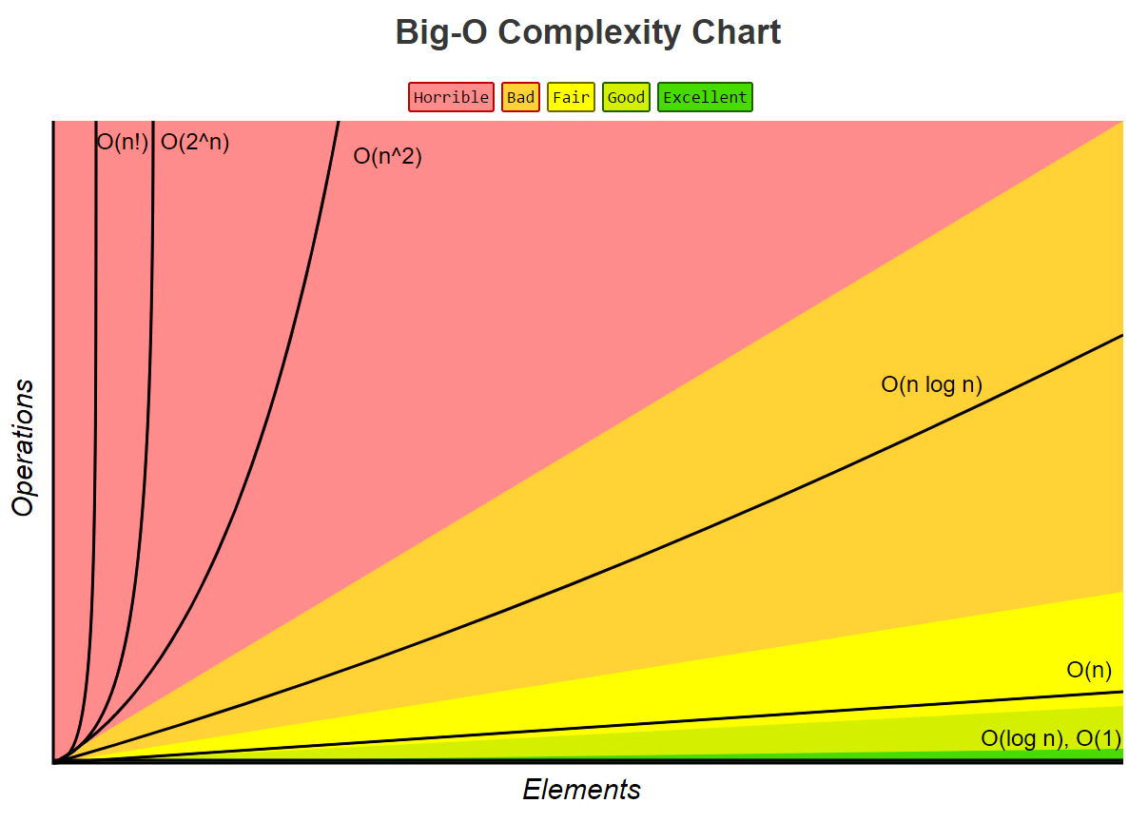
Sorting Summary
Average Case
Insertion Sort
Mergesort
Heapsort
Quicksort
Radix Sort
Counting Sort

Slide 142
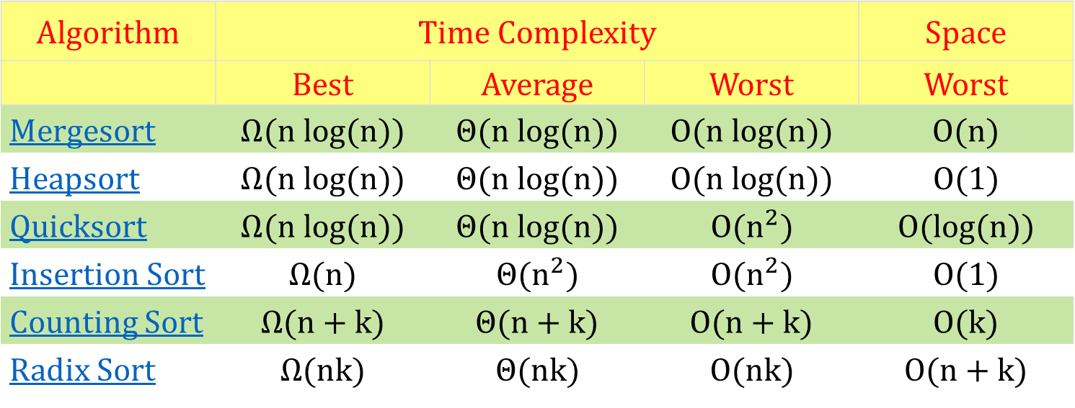
Sorting Summary
Algorithm | Time Complexity |  |  | Space
 | Best | Average | Worst | Worst
Mergesort | $$Ω(n log⁡(n))$$ | $$Θ(n log⁡(n))$$ | $$O(n log⁡(n))$$ | $$O(n)$$
Heapsort | $$Ω(n log⁡(n))$$ | $$Θ(n log⁡(n))$$ | $$O(n log⁡(n))$$ | $$O(1)$$
Quicksort | $$Ω(n log⁡(n))$$ | $$Θ(n log⁡(n))$$ | $$O(n^{2})$$ | $$O(log⁡(n))$$
Insertion Sort | $$Ω(n)$$ | $$Θ(n^{2})$$ | $$O(n^{2})$$ | $$O(1)$$
Counting Sort | $$Ω(n+k)$$ | $$Θ(n+k)$$ | $$O(n+k)$$ | $$O(k)$$
Radix Sort | $$Ω(nk)$$ | $$Θ(nk)$$ | $$O(nk)$$ | $$O(n+k)$$

